Slide 1
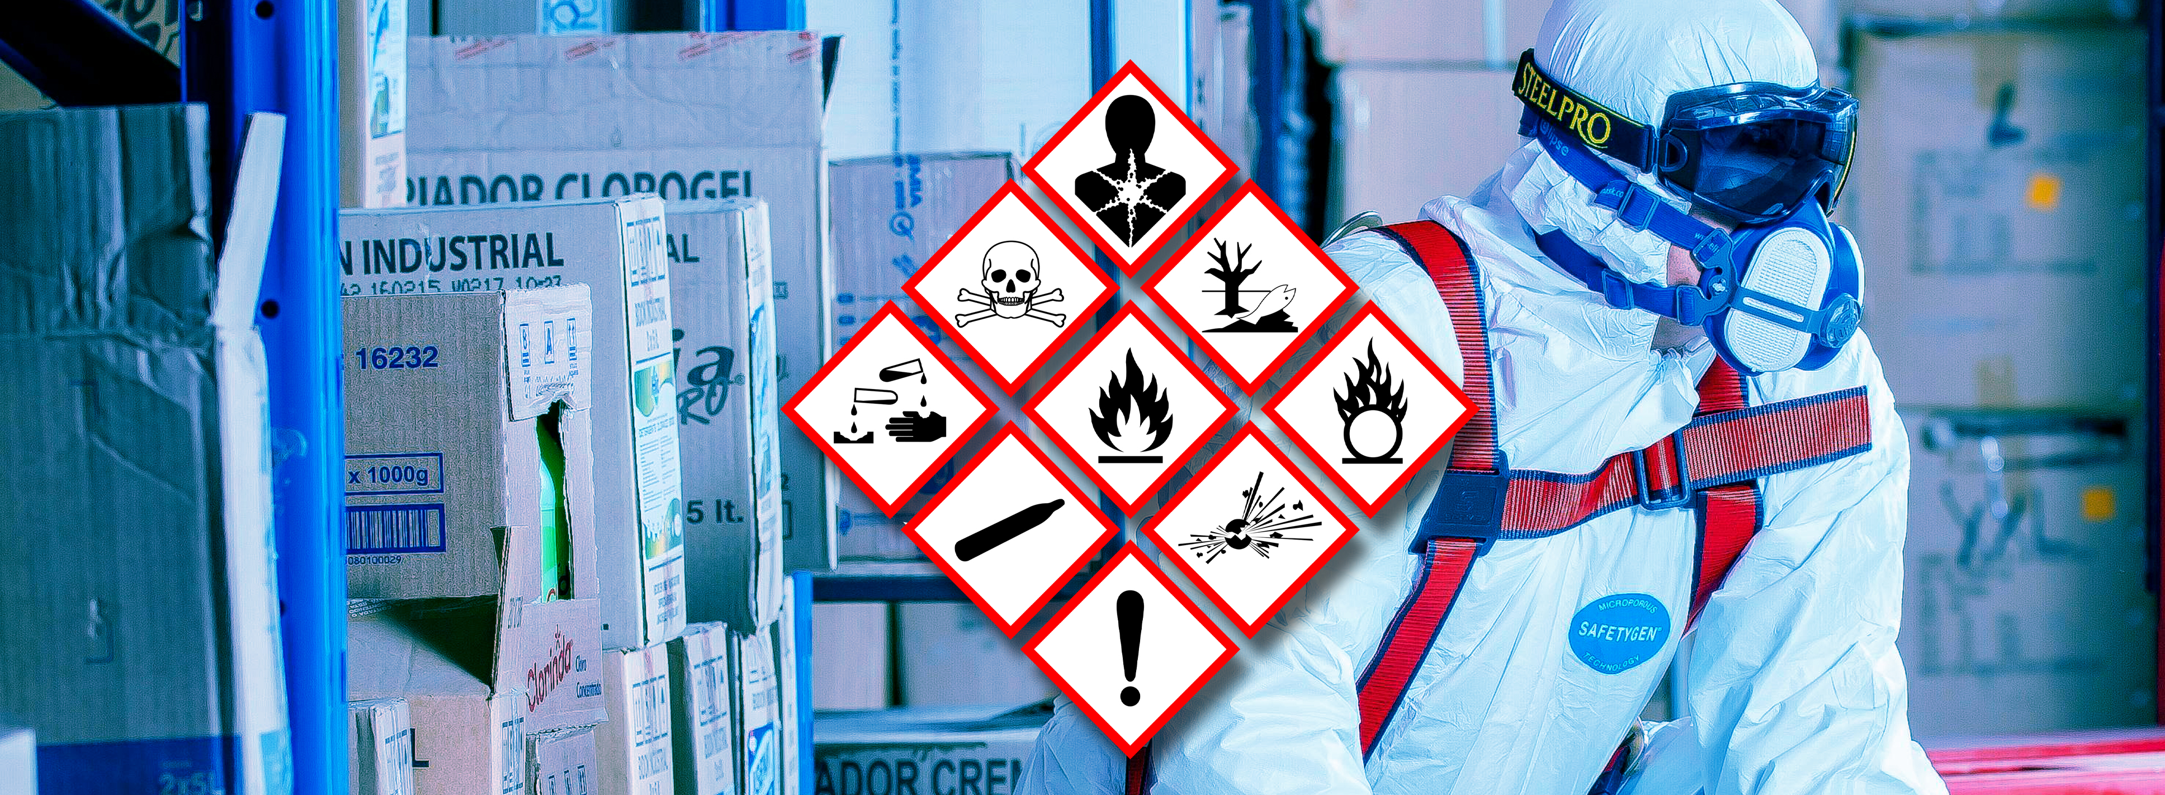
Toolbox
Hazardous substances
Company name and date

Slide 2

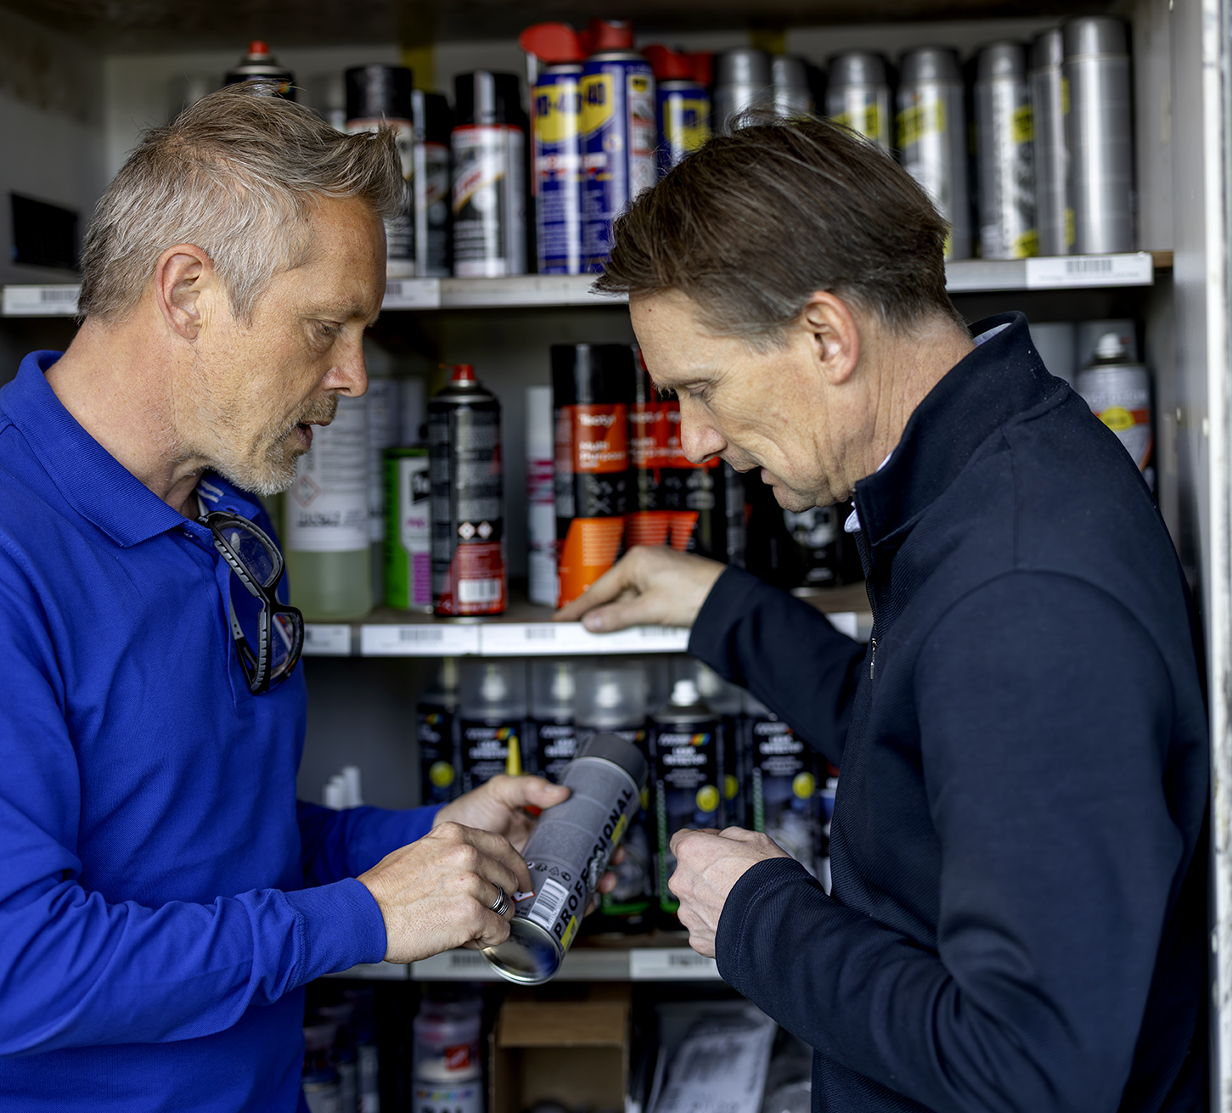
Contents
Safe and healthy working practices | Hazardous substances
What are hazardous substances?
How can you recognise hazardous substances?
How are you exposed to hazardous substances and what are the risks?
What does the Working Conditions Act say?
What can you do yourself?
Questions?

Slide 3
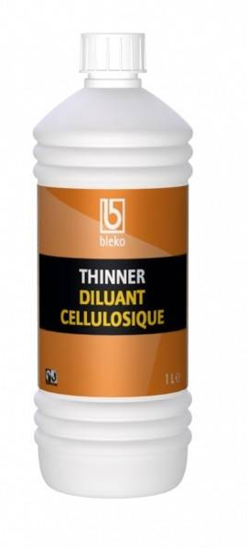
Hazardous substances are substances that may pose a risk to the safety and health of employees.
These substances may be found in packaged products, such as lubricants. Hazardous substances may also be produced during work. An example is welding fumes.
Safe and healthy working practices | Hazardous substances
What are hazardous substances?
Notes:
Water can also be a hazardous substance. For example, if you consume more than 7 liters of water at once, you can die. According to the law, hazardous substances are all products with a hazard pictogram and hazardous substances resulting from certain processes.

Slide 4
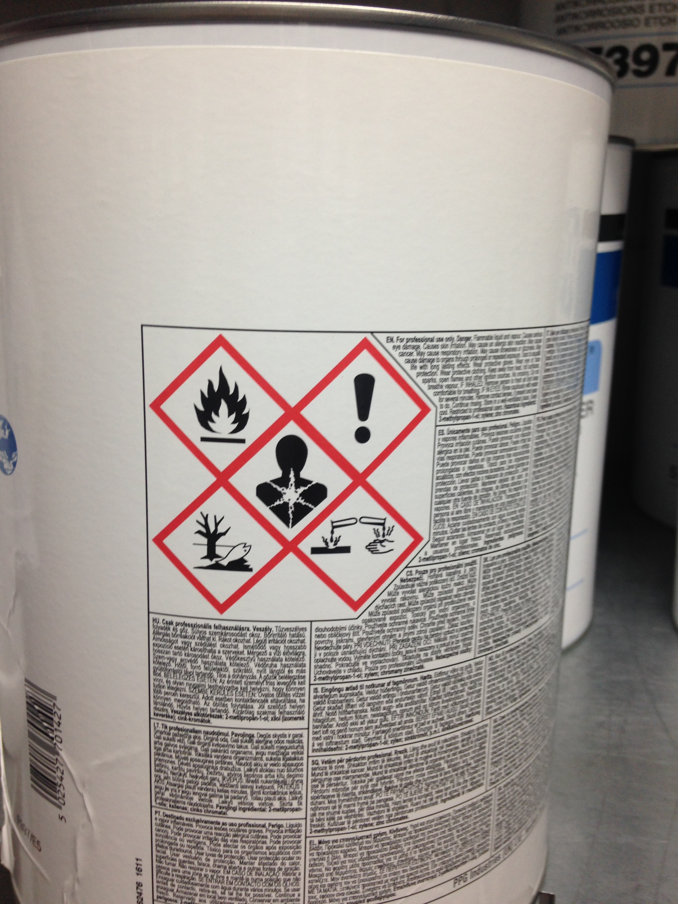
Safe and healthy working practices | Hazardous substances
How can you recognise hazardous substances?
Hazardous substances can be recognised by their label:
Hazard symbols
H-phrases statements about the hazard
P-phrases about the measures to be taken
Notes:
Show a product from your company and ask what the most important information on the label is/means.
Paste the photo of this product (label with hazard symbols) into this slide.

Slide 5









Safe and healthy working practices | Hazardous substances
hazard symbols
Explosive
Corrosive
Flammable
Toxic
Oxidising
Irritant, sensitising, harmful
Long-term health hazard
Gases under pressure
Hazardous to the aquatic environment
Notes:
Ask participants what these hazard symbols mean.
NOTE: The symbols on the left indicate physical hazards, while the symbols on the right in the block indicate health hazards.
NOTE: Clearly indicate that the symbol indicates long-term harmful and toxic substances with the most serious health risks.

Slide 6

Safe and healthy working practices | Hazardous substances
Hazardous substances that arise during work
Work can give rise to hazardous substances:
Wood : sanding, milling, drilling
> Wood dust
Stone/concrete : drilling, grinding, etc.
> Quartz dust
Diesel : diesel engine emissions
> DME
Welding
> Welding fumes

Slide 7
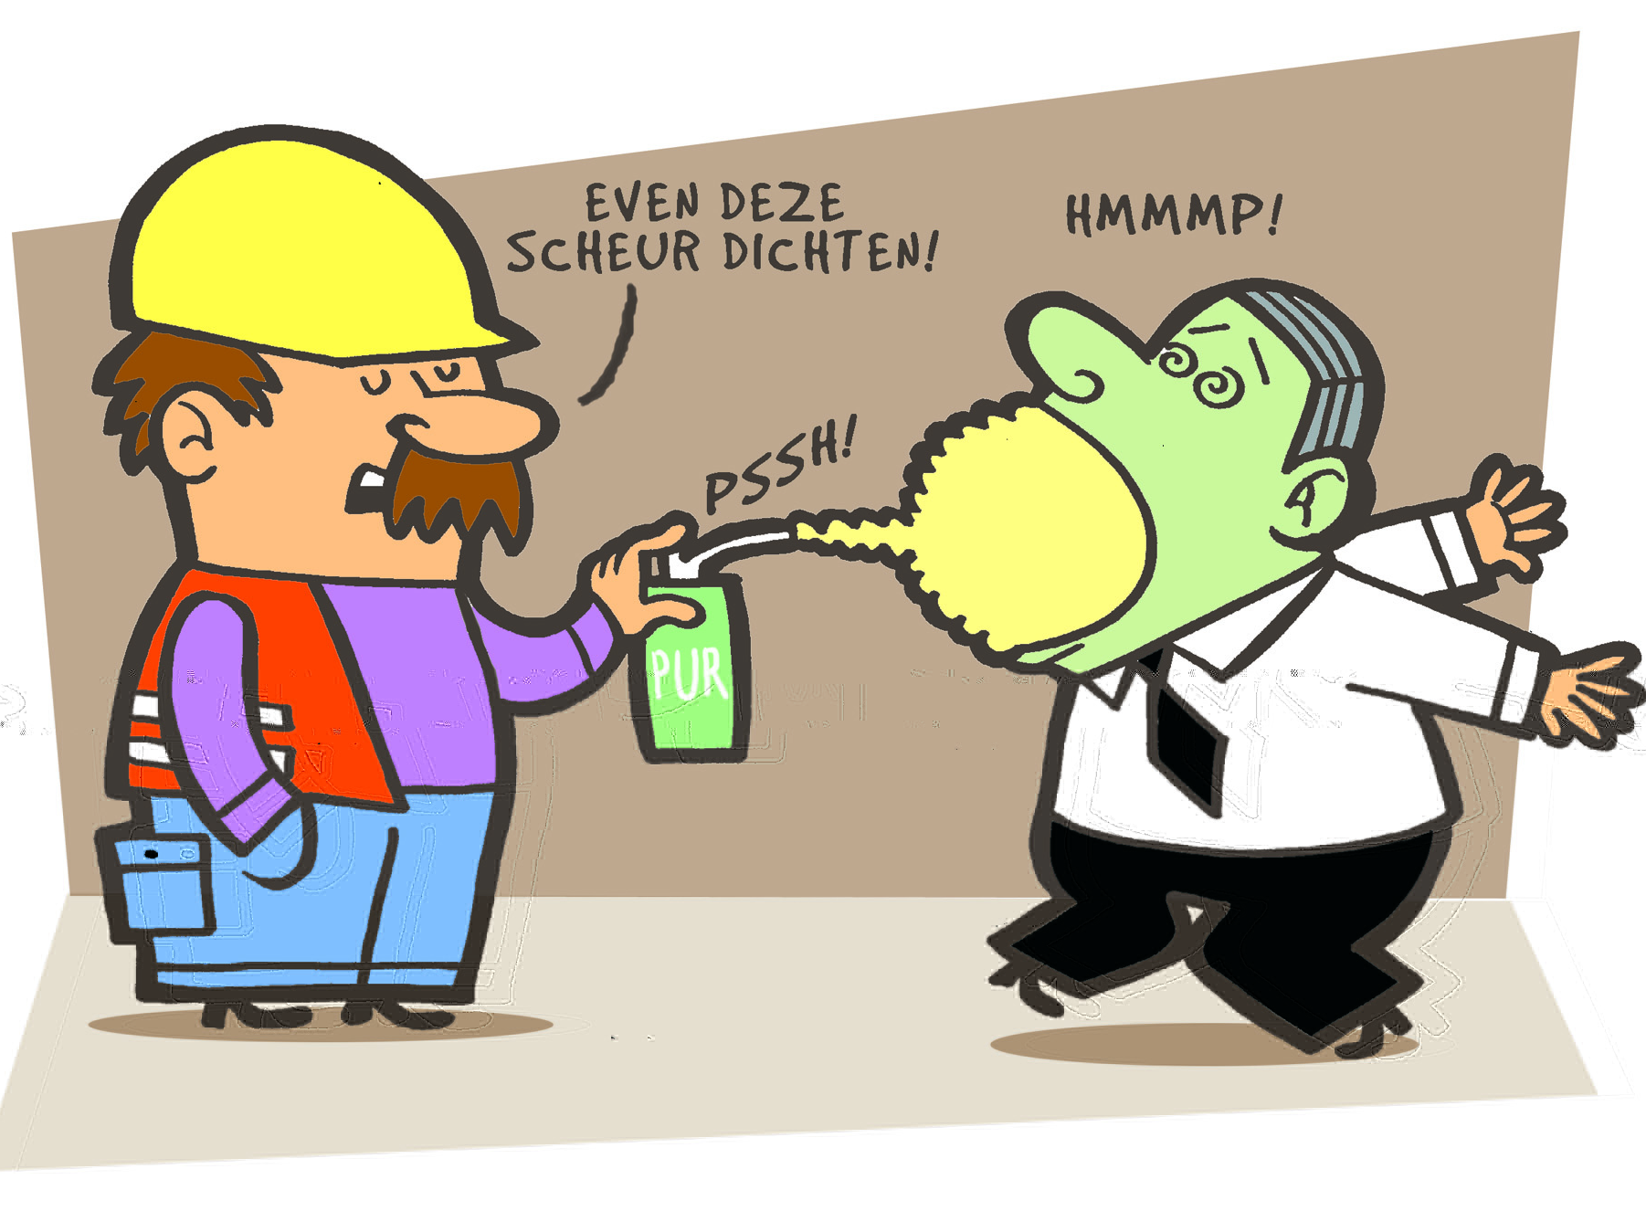
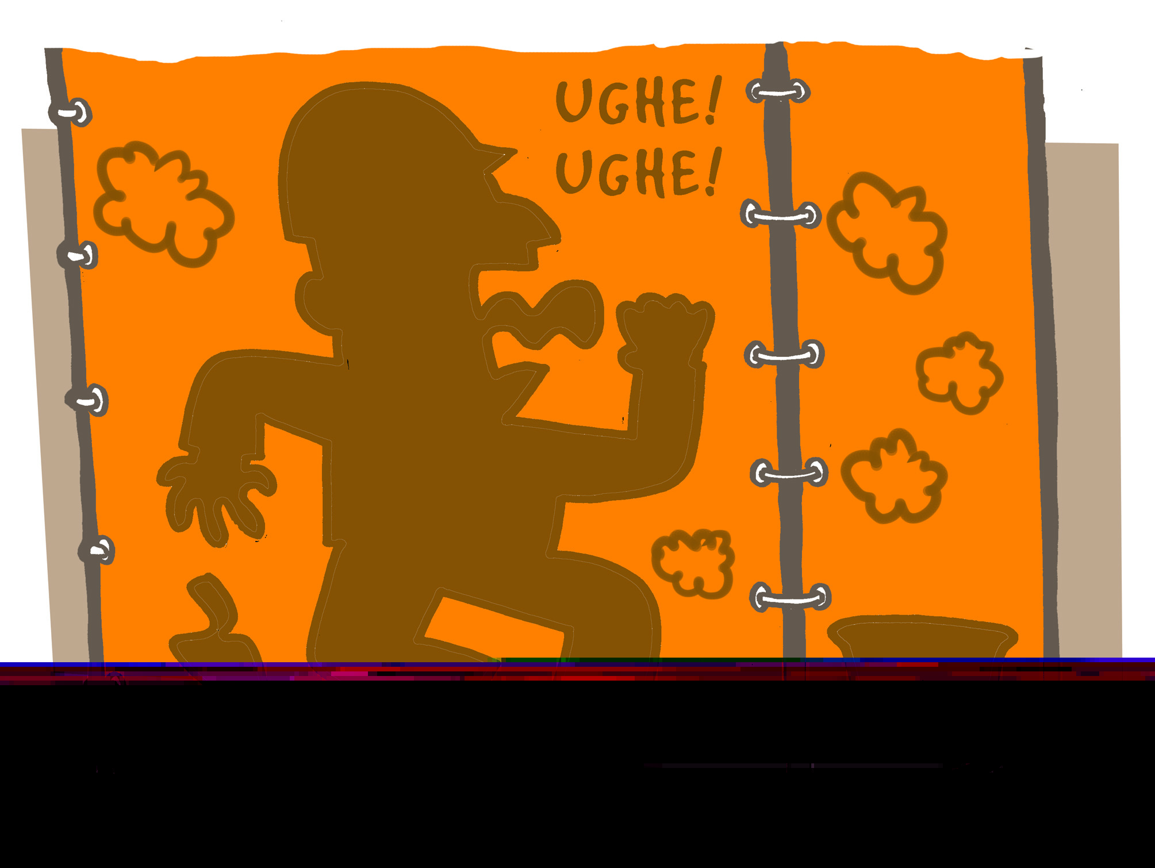
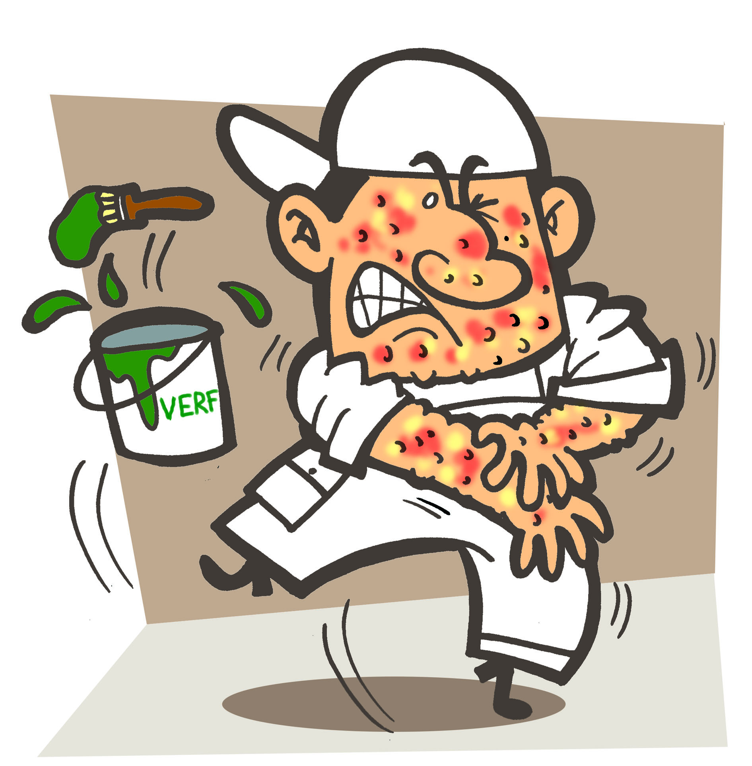
Safe and healthy working practices | Hazardous substances
Exposure to hazardous substances
Inhalation : vapour, gas and small dust particles
Ingestion : eating and smoking
Through the skin : touching and splashing
What is the main risk posed by the substances in your company?

Slide 8

Safe and healthy working practices | Hazardous substances
Serious consequences
1. The harmfulness of the substance to health (nature)
2. The amount to which you are exposed (degree)
3. How long you are exposed to it (duration)
Note:
There are substances that can have (serious) effects only after a longer period of time (e.g. welding fumes and solvents).

Slide 9
Safe and healthy working practices | Hazardous substances
Effects of hazardous substances
Hazardous substances can have an immediate effect and a long-term effect.
Immediate effect:
inhaling solvents : headache and dizziness
inhaling chromium VI : - (no immediate effect)
Long-term effect:
inhaling solvents for years : damage to the nervous system (Chronic Solvent-Induced Encephalopathy (CSE))
inhaling chromium VI : lung cancer or asthma 10-20 years later

Slide 10
Safe and healthy working practices | Hazardous substances
What does the Working Conditions Act say?
All hazardous substances must be inventoried and registered.
The nature, extent and duration of exposure must be assessed and checked against the limit values.
There is separate legislation for CMR substances.
Measures according to the occupational hygiene strategy (STOP)
Consult the safety data sheet for information about the product
Consult the “hazardous substances” self-inspection tool.

Slide 11

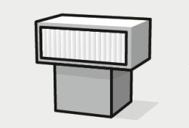
Safe and healthy working practices | Hazardous substances
Occupational hygiene strategy (STOP)
Substitution:
replace a hazardous
substance with a
non-hazardous or less
hazardous substance
Organisational measures:
working arrangements that
help to prevent exposure and reduce the number of
employees exposed
(job rotation)
Technical measures:
Technical measures that help prevent exposure (extraction)
Personal protective equipment

Slide 12
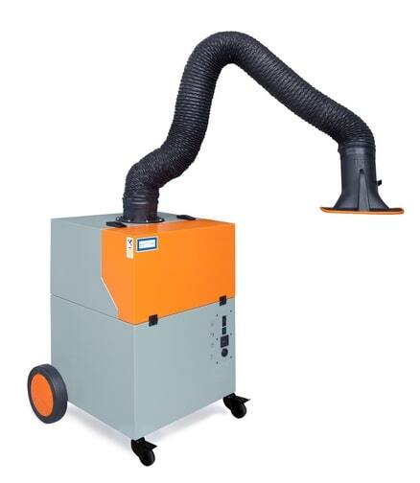
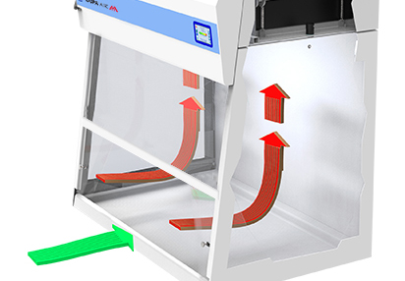
Safe and healthy working practices | Hazardous substances
What can the employer do?
Use other (less hazardous) products
Ensure adequate ventilation
Introduce other working methods (cutting instead of sawing)
Job rotation
Provide instruction on handling hazardous substances
Work in closed systems
Ensure extraction
Ensure appropriate personal protection

Slide 13
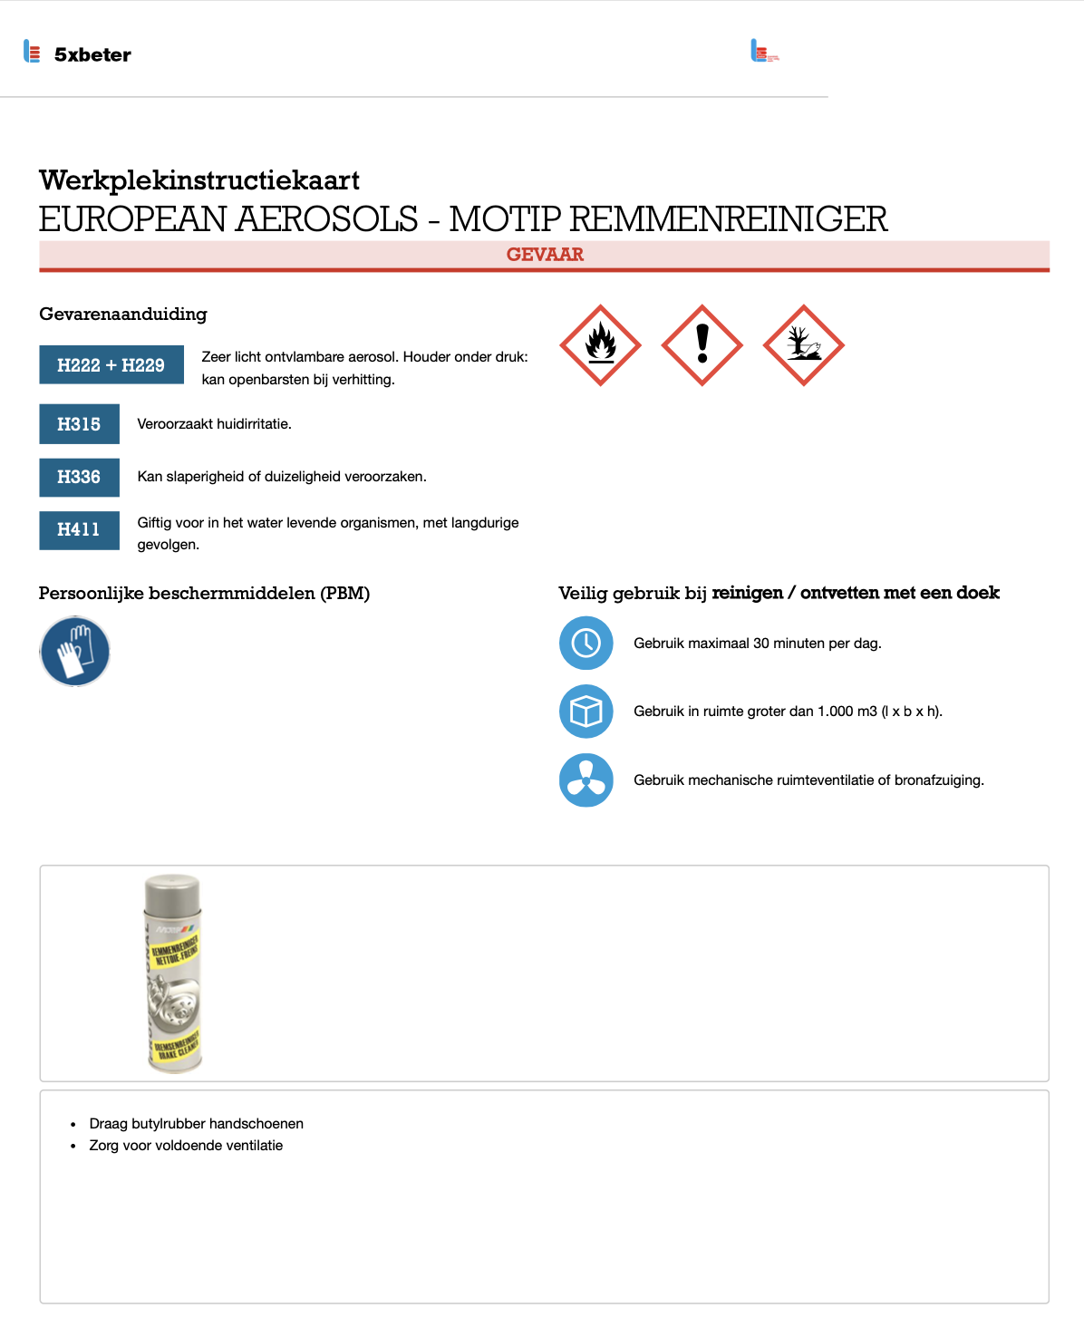
Safe and healthy working practices | Hazardous substances
Instruction with a workplace safety card
The purpose of the workplace instruction card is to inform employees and others in the workplace about the risks of the substances and the necessary measures to be taken.

Slide 14
Safe and healthy working practices | Hazardous substances
What can you do yourself?
Be prepared!
Read the label and follow the instructions.
Consult the workplace safety card.
If in doubt, consult your manager.
Work hygienically!
Do not eat, drink or smoke in the workplace.
Wash your hands when leaving
the workplace (before eating, drinking/break).
Change your clothes when leaving the workplace.
Prevent exposure!
Close the packaging after use.
Use extraction and/or ventilation where necessary.
Use prescribed PPE.

Slide 15
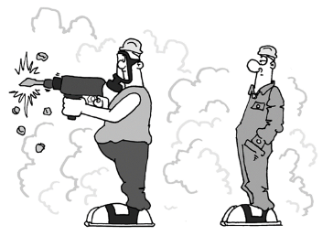
Safe and healthy working practices | Hazardous substances
Tips
Also pay attention to whether colleagues in the vicinity are working with hazardous substances.
Warn your colleagues if you are going to be working with hazardous substances.
Note: products are sometimes transferred to other packaging without a label.
Put on clean work clothes every day. Putting on dirty clothes causes hazardous substances to come into contact with your skin.

Slide 16

Safe and healthy working practices | Hazardous substances
Questions?
info@5xbeter.nl | www.5xbeter.nl

Slide 17
Safe and healthy working practices | Hazardous substances
Need help?
Discuss it with your manager or contact the health and safety officer.
Consult an Improvement Coach from 5xbeter: www.5xbeter.nl
Or call the FREE Improvement Line: 0800 – 55 55 005
info@5xbeter.nl | www.5xbeter.nl

